Slide 1
Microservices and DevOps
Scalable Microservices
Stability Antipatterns
Henrik Bærbak Christensen

Slide 2

Release It!
Written by what is obviously a highly skilled practitioner ☺
Definitely not written by an academic ☺? ☹ ?
I have had to write most of the definitions to pinpoint the terminology used…
Each section does not follow a pattern template
(name, problem, solution, forces)

Slide 3
Punch line…
Cynical software expects bad things to happen and is never surprised when they do. Cynical software doesn’t even trust itself.
A highly stable design usually costs the same to implement as an unstable one.
Hm? I think Nygard means ‘the total cost over lifetime’ here…
Notes:
P 23+24

Slide 4
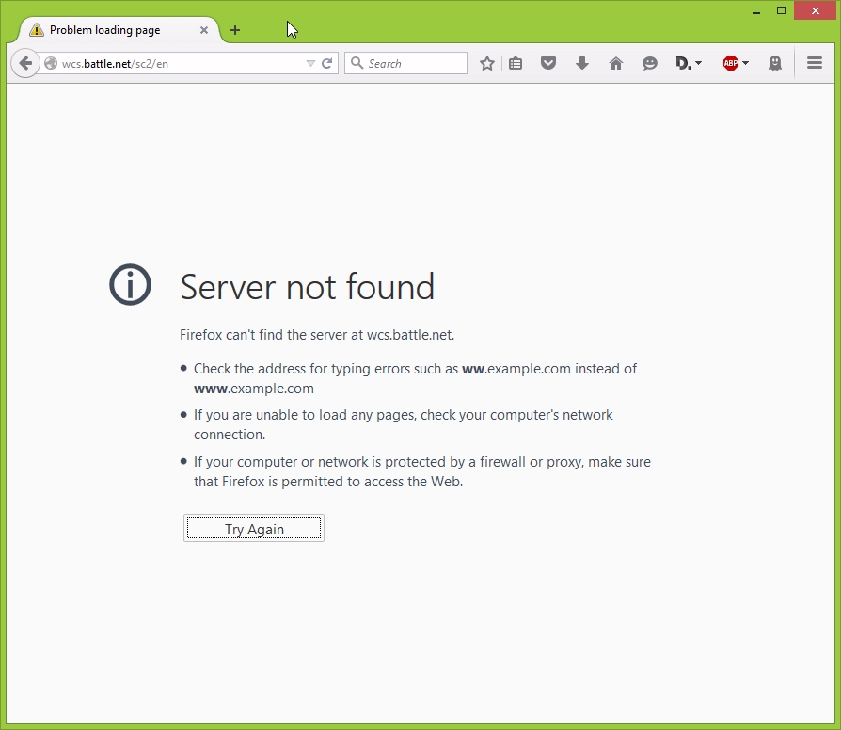
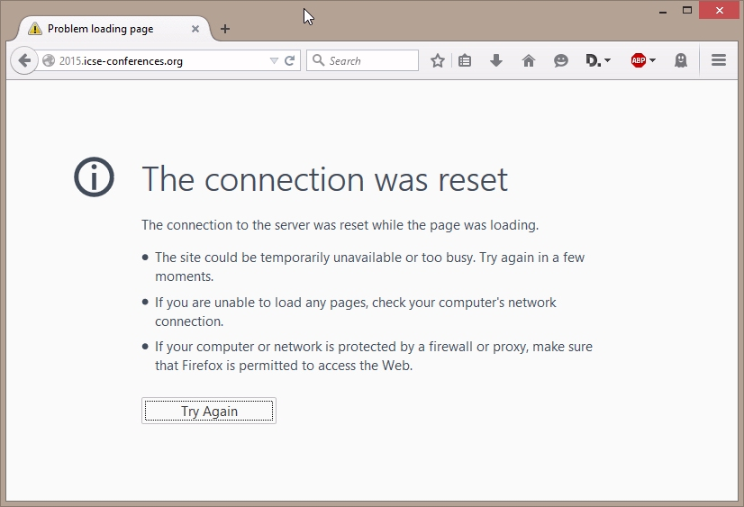
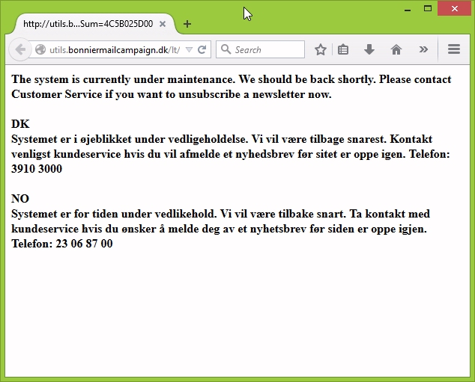
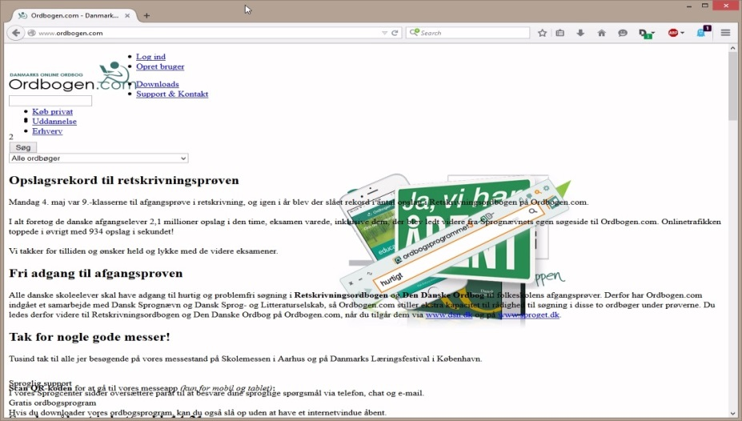
About a half year of ‘ups’
Notes:
While developing my Cloud computing course I generally did a screen snapshot every time some service did not respond. I was a bit surprised how often this actually happens!

Slide 5
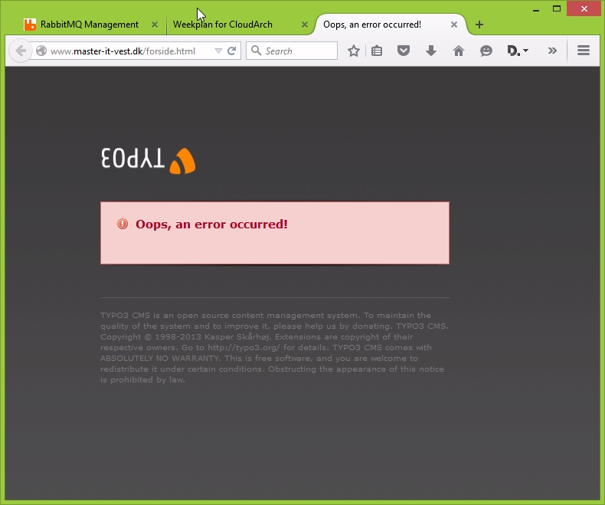
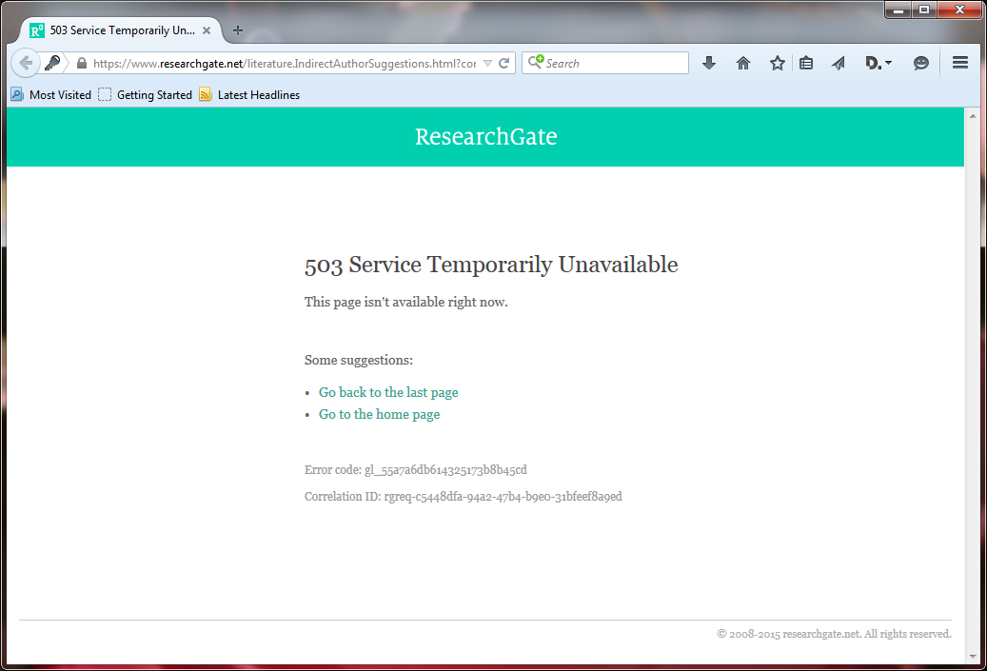
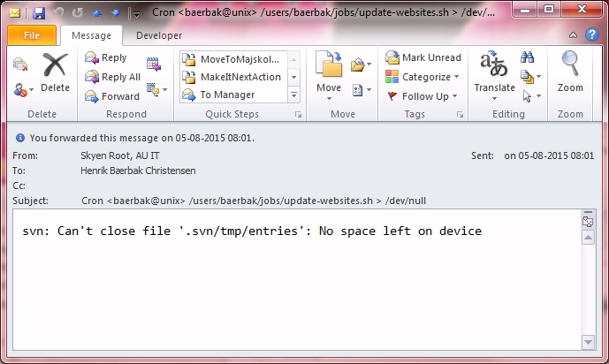

Slide 6
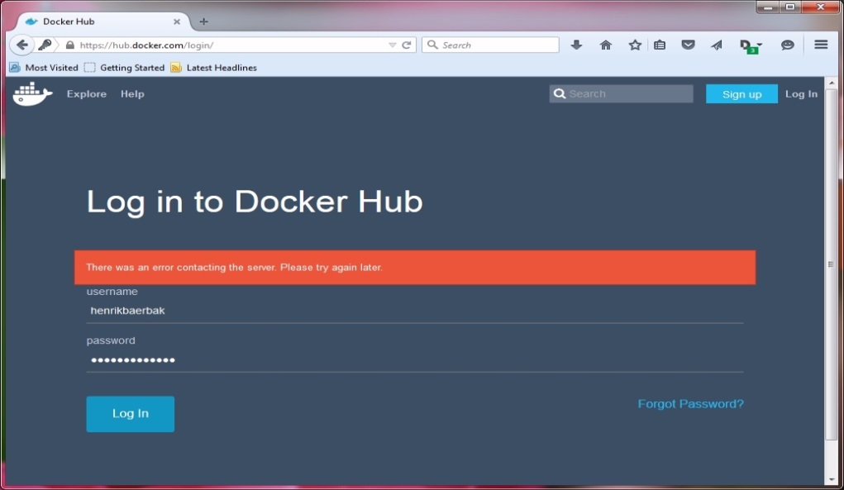
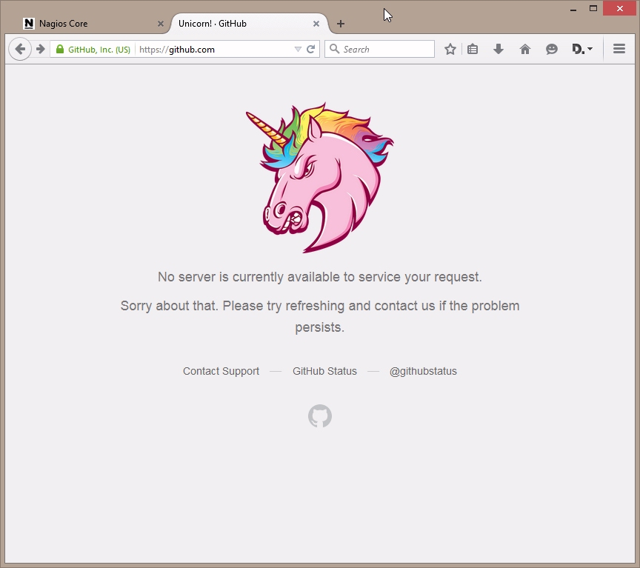
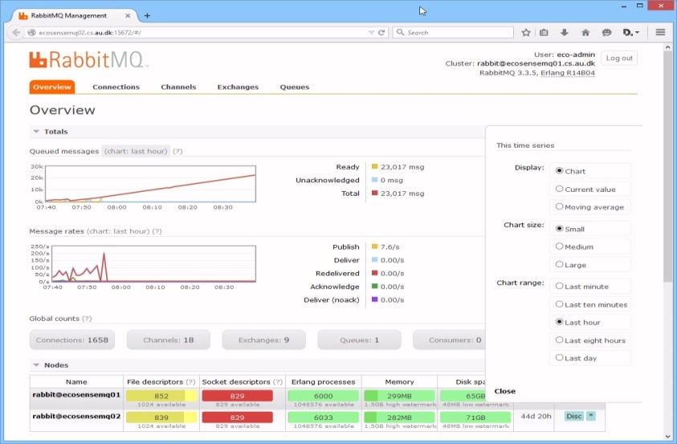

Slide 7
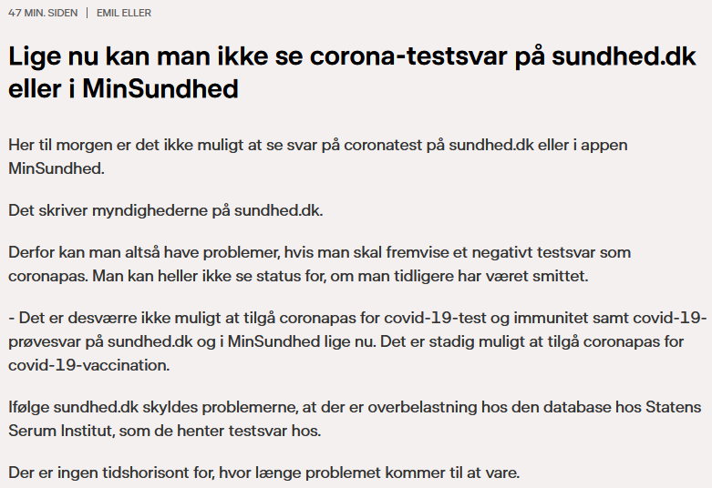


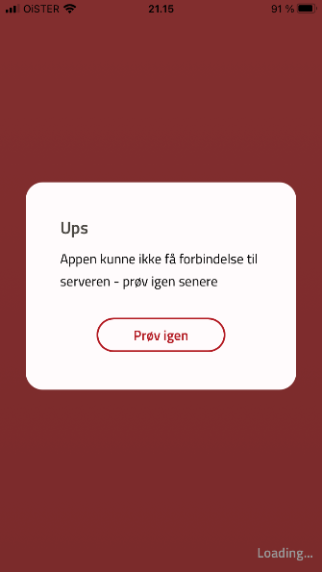
More recent
Notes:
7-6-2021

Slide 8
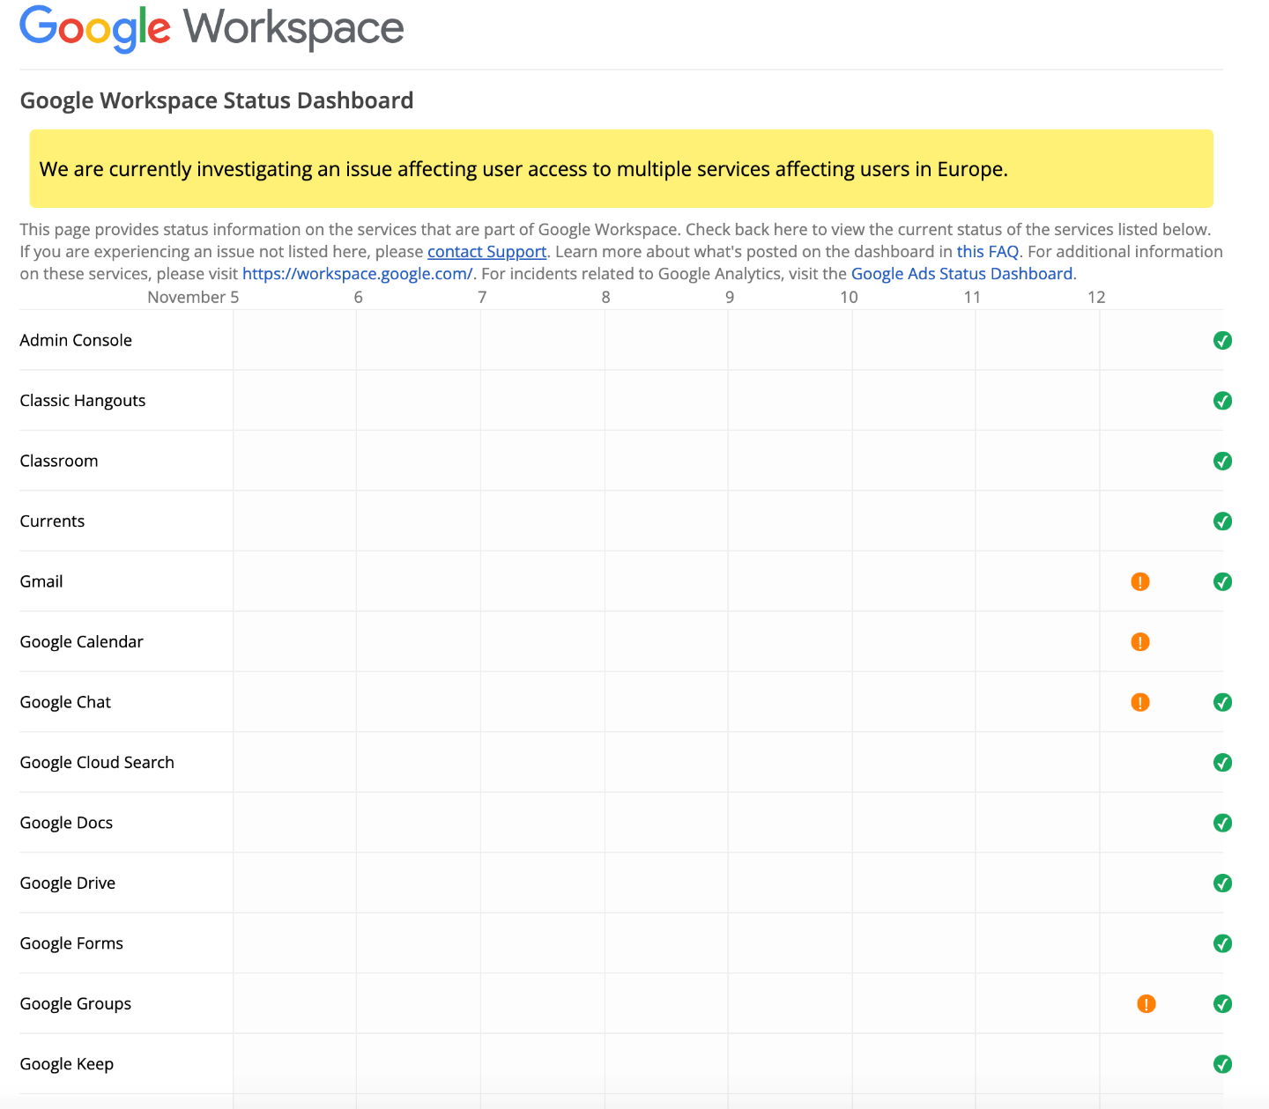

Slide 9
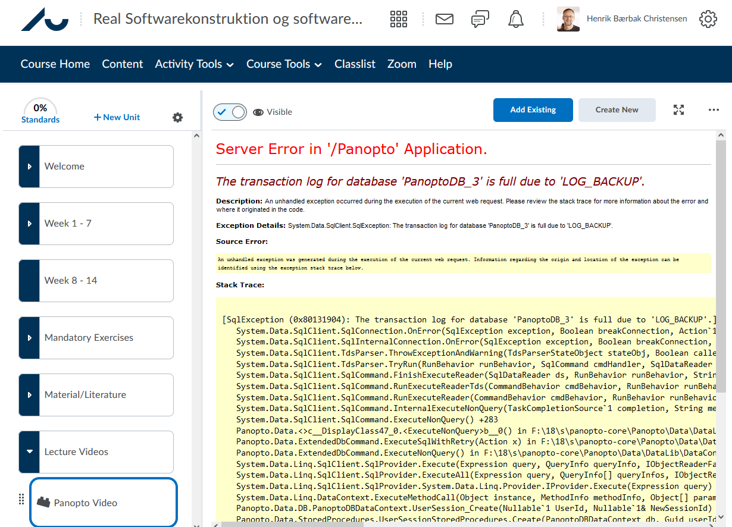
And

Slide 10
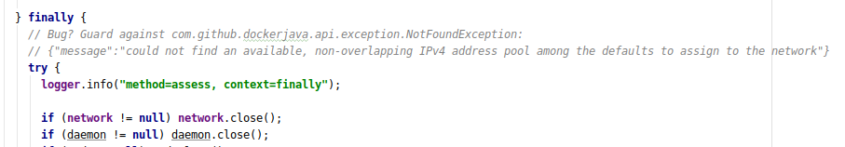
Akin to Nygard §1
MSDO 2020 Crunch broke down. Why?
No try catch around ‘network.close()’ in my finally() clause ☹
Was due to the ‘only 16 networks available’ default docker setup
Notes:
Bug (issue?) detected during MSDO 2020 launch of Crunch. Only found in production because my test runs never tested 15 groups at the same time, only one or two. Kind of ‘scaling effects’ bug

Slide 11
Another one
Crunch3.baerbak.com
The central submission server
Fixed IP in my own range, provided by AUIT
During maintenance September 2016 they shut down this range’s DNS name servers without telling me!
Result: All my servers could not see the internet!
And no warning at all!
Morale: My software in production change even
when I do not change my software!
Notes:
One of the things I have learned by doing OPS! Software change even if I do not change software

Slide 12
Definitions
Transaction: Abstract unit of work processed by the system
More akin to ‘story’ (XP) or ‘use case’
System: Complete, interdependent set of hardware, applications, networks, power supplies, and services required to process transactions
Impulse: Rapid shock to the system
Stress: Force applied to the system over extended time
Reusing mechanical engineering terminology
Notes:
Nygard §3

Slide 13
Definitions
Strain: Changed shape when stress is applied.
Longevity: Ability to keep processing transactions for a long time [long = more than timespan between deployments]
Crack: essentially synonym with failure
Failure mode: the trigger, the way cracks propagate, and the result of the damage
Safe failure modes are better than unpredictable failure modes!
Crackstoppers: failure modes that keep cracks away from indispensable system parts
Notes:
Strain example: Stressing means eating more and more RAM
Longevity: My mongoDB are now on 1.2 TB and I have 2TB. And I have tested what happens to MongoDB when they run out of disk. Disaster! And difficult to test in staging env, as you often do not run long enough or hard enough… I had to make a small disk machine to diagnose how Mongo behaves, little documentation found on that issue!
Crackstopper is a weird term, I prefer ‘safe failure mode’ which he also defines later

Slide 14
Examples
Straining the system
Requests get queue up
Queues grow
RAM exhausted – start swapping to disk
Requests get queue up much much faster…
… disaster…

Slide 15
Stability
Accept that failure will happen! (‘Design for failure’)
Safe failure mode: A failure mode that contains the damage and protects the rest of the system.
Stability (resilience, longevity): Ability to keep processing for a long time even when there are transient impulses, persistent stresses, or component failures
Analogy: Crumble zones in modern cars…
Notes:
Safe failure mode analogy: crumble zones in cars, allows the chassis to suck up the forces while keeping the passengers safe

Slide 16
Compare to Bass, 3rd Ed
Availability (1): Property of software that it is there and ready to carry out its task when you need it to be.
Avizienis el al.: Dependability is the ability to avoid failures that are more frequent and more severe than is acceptable
Availability (2): Ability of a system to mask or repair faults such that the cumulative service outage period does not exceed a required value over a specified time interval
Stability (resilience, longevity): Ability to keep processing for a long time even when there are transient impulses, persistent stresses, or component failures

Slide 17
Discussion
Student report: “As my program is running on Amazon EC2, it is always available”
What is the ‘system’ definition here?
Ragnarok (my phd project) crashed due to an unhandled ”disk full” error and left the persistent data structure in an inconsistent state
Impulse, strain, crack, ?
Potential safe failure mode?

Slide 18
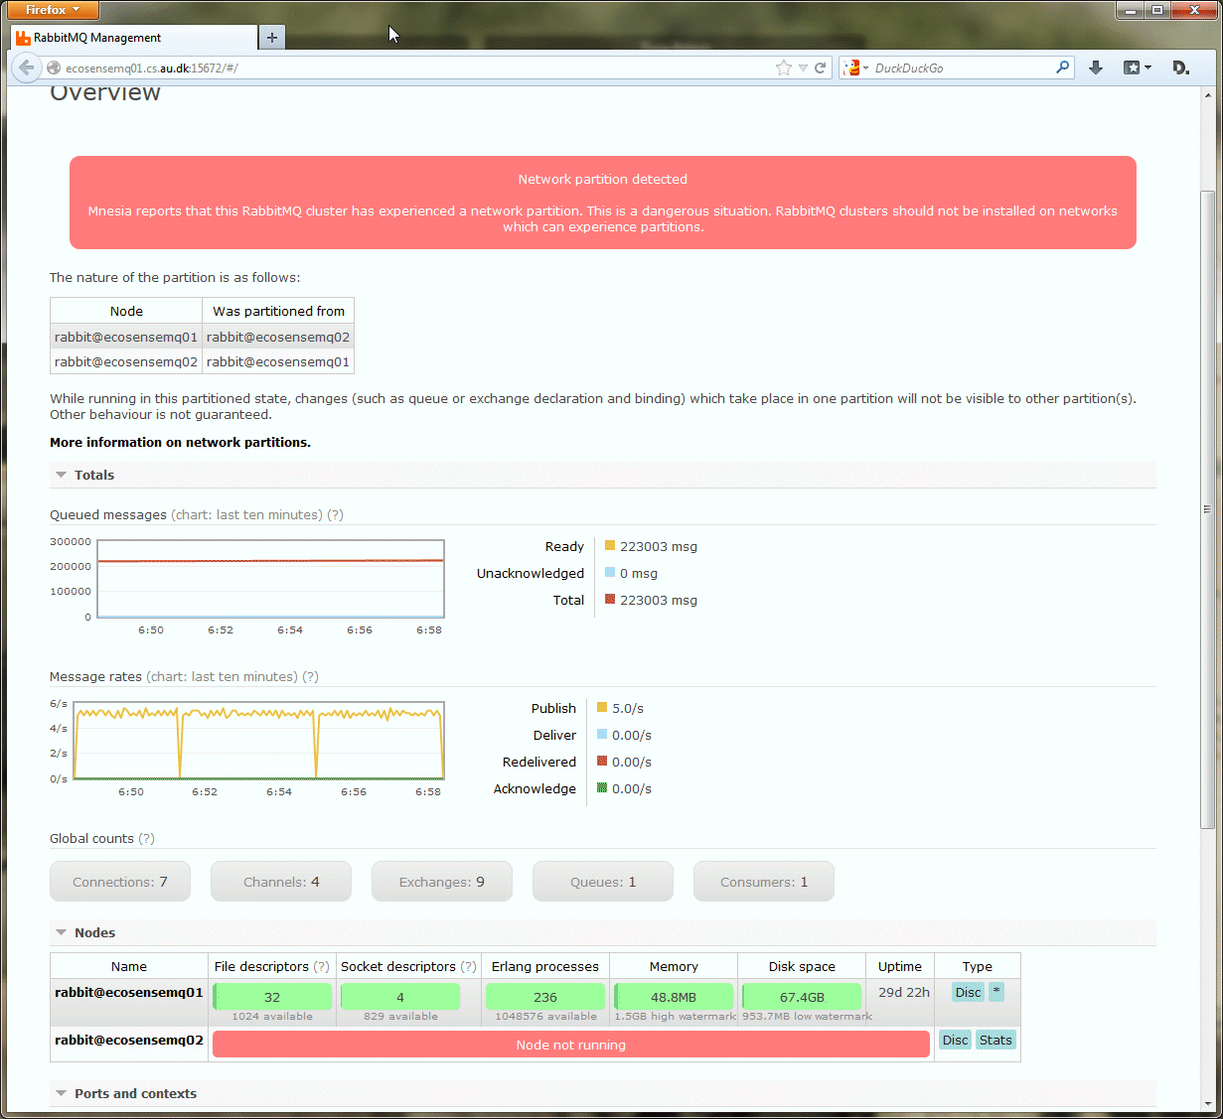
Discussion
Notes:
Network partition between two clustered RabbitMQs. Simple crack – but the doc’s say – you really cannot recover!

Slide 19
Discussion
Oct 20 2013
Grundfos dorm server did not send data for 26 hours
Normally 70KB/s
On Oct 21 it went online again, pumping all accumulated data into Karibu during 51 minutes (70Kb/s x 26 hours = lot!)
Impulse, strain, crack, ?
Notes:
Example of strain

Slide 20
Chain of failure
Cracks propagate!
At each step
It can be accelerated
It can be slowed
It can be stopped
And…
High level complexity → more directions for cracks to propagate
Tight coupling → accelerate cracks

Slide 21
Crack analysis
Process: Look at every
External/remote call
Every I/O
Every use of resources
Every expected output
Every mutex/synchronized/critical region
… and ask
What are all the ways this can go wrong?
Analyze types of impulses and stresses

Slide 22
Examples
What if I cannot make the initial connection?
What if it takes 10 minutes?
What if I get disconnected?
What if it takes 2 min to respond?
What if 100.000 queries arrive at any one time?
What if my disk is full when I try to log the error message from the SQLException that happened because the network during the update transaction while…?

Slide 23
Stability Antipatterns
14 root causes that create, accelerate or multiply cracks and lead to system failures

Slide 24
Integration Points
Integration Points: Points in the software that integrate with external systems [My shot at a definition!]
Sockets, process, pipe, RPC, file access, database call, feed, …
Even calls to critical regions ala synchronized methods
Lessons to remember
Every integration point will eventually fail in some way
Failures take several forms. You will not get nice error messages
Failures propagate quickly
Know when to open up abstractions
Cracks does not respect your nice role boundaries ☺

Slide 25
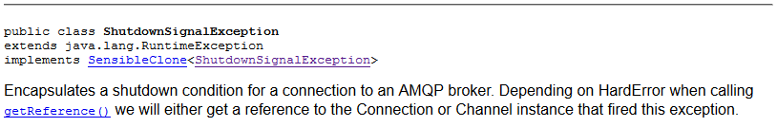
Ex: RabbitMQ Java library
Thanks for nothing…
My perception is that failure conditions are often poorly documented. I need to understand the root cause…
Finding the underlying problem, require to open up the abstraction
Ahh – plowing through MongoDB connector source code ☹

Slide 26
Integration Points
In my mind ‘Integration Points’ is not really an anti-pattern
It is more the central concept/term we will apply for all those ‘code segments’ that pose a stability issue, and can lead to all the other anti-patterns.

Slide 27
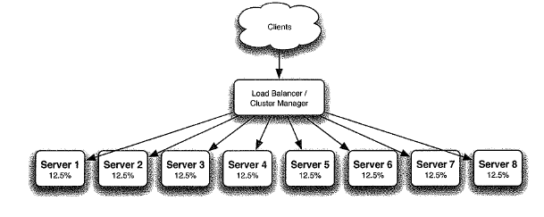
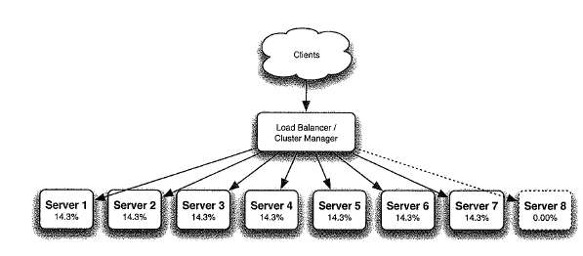
Chain Reactions
Scaling
Horizontal: More machines (Google way)
Vertical: Bigger machine (Oracle way)
Load-balancing over horizontal farm
One server down: Load distributed

Slide 28
Chain Reactions
If one server failed due to load-related condition, the rest of the pool are now more likely to fail!
Chain Reaction: One failure (often resource/load related) in one server leads to increased probability of failures (often of similar type) in other servers [My shot at a definition!]

Slide 29
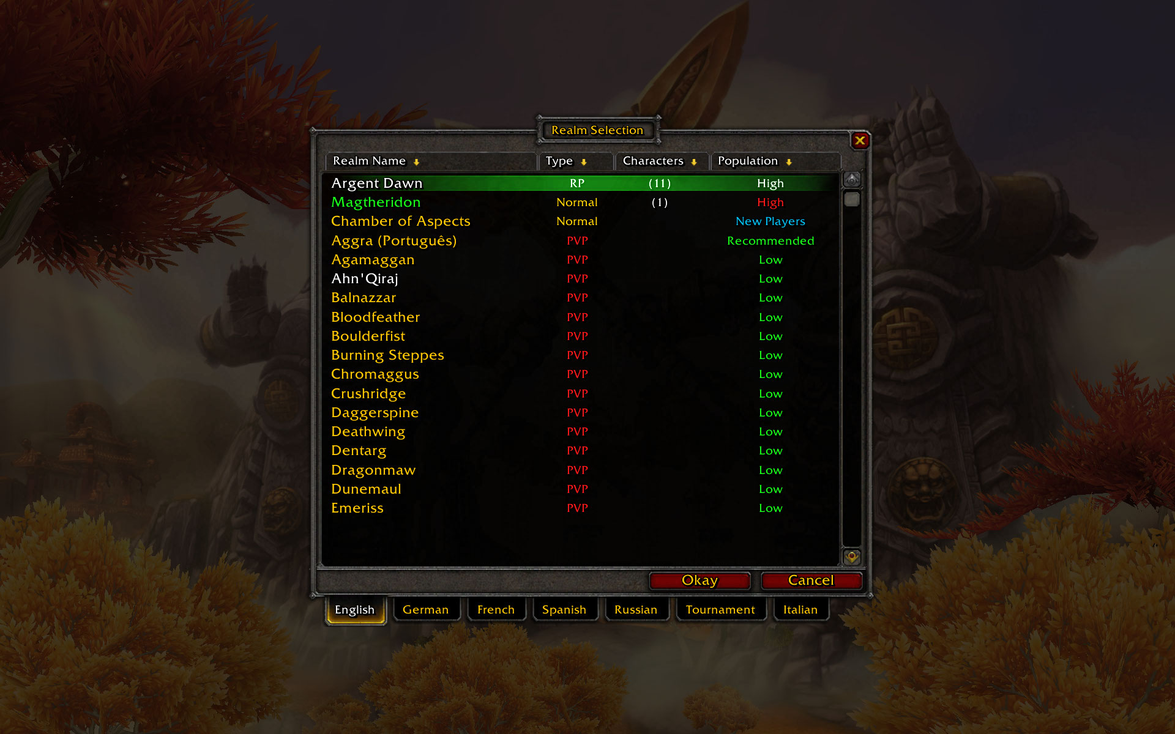
Ex: WoW Realms
World of Warcraft
Realms safeguard against Chain Reactions
Real hard way of load-balancing…

Slide 30
Cascading Failures
Cascading failure: A failure that ”jumps the gap” from one service or layer to another [My shot at a definition!]
Example: Database failure, cascades into app server.

Slide 31
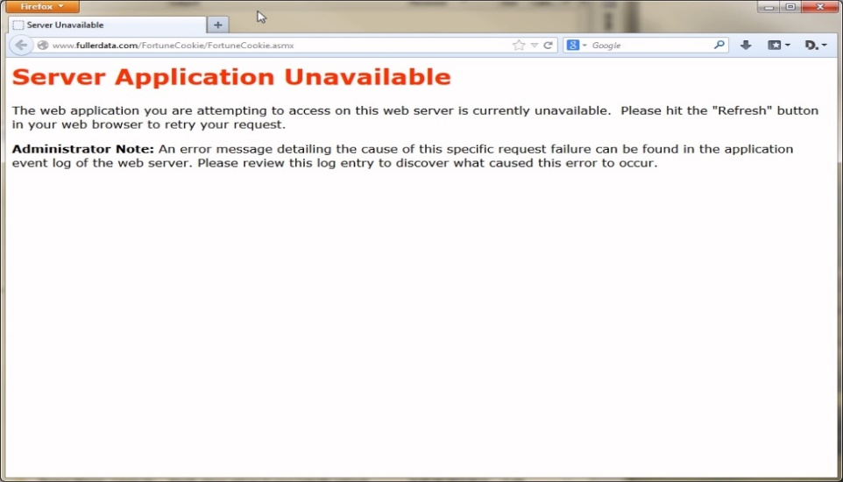
Example
In a 2014 course I made a Facade service, delegating to a fortune cookie service I found on the internet
It, however, failed right after the seminar in which I introduced it ☹
In MSDO, I wanted to reuse a ‘weather service’ that was introduced in my Cloud Computing course, only to find the underlying service was discontinued.
Rewrote it into the ‘quote service’…
Notes:
The fortune cookie service that my REST service uses failed right after the seminar in which I introduced it!

Slide 32
Users
Human users have a knack for creative destruction…
Users means memory is consumed
Users do unpredictable things to your apps
Users may be malicious
Users will gang up on you
”Your site will get slashdotted”
Slashdotted = posting a web URL on slashdot will cause a large surge in web traffic, which can overwhelm small sites…

Slide 33
Users
And then there are the ‘Unwanted users’
Bots that screen scrape your site to lure your prices
Competitive intelligence
Nygard mention some tricks to block them of
Robots.txt only work with the nice ones
Firewalling them off
Sue them

Slide 34

Blocked Threads
In the good old Amiga days, you knew a crash ☺
Modern JVMs seldom crash the machine but just hangs in deadlocks, doing nothing useful.
Blocked threads: All processes are blocked waiting on some impossible outcome

Slide 35
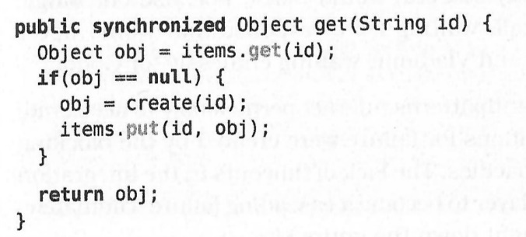
Example
System uses ‘ObjectCache’ with ‘get()’
Interface says nothing about ‘synchronization’, but the implementation does…
‘create’ does external call to inventory system
… which crash due to ‘unbalanced capacities’
Now, first thread to do cache miss calls ‘create’ which will wait for response that never comes (and never release lock on this)
And all other will block as well, even if item in the cache…
Is slow, so they make a ‘Caching Proxy’:
If (incache) return cache; else super.get()
Notes:
I actually think the discussion in Nygard is highly confusing. As far as I know, synchronized is NOT inherited, but has to be specified for each method in each subclass (it does break the liskov principle, as stated by Nygard, yes), and only applies if the actual object’s type had it declared. So the discussion about subclassing and Liskov is in my view not that relevant. The key point is a thread blocks on create() making all other block as well.

Slide 36
Self-Denial Attacks
Self-Denial Attacks: Impulses that are generated from your own organization
Ex
Winter storm: Lystrup skole webpage
We do not know if school will be operating. Check back at 07.00 o’clock
The Kähler vase incident
Put a specific vase on sale on a specific time
Which caused the web site to crash

Slide 37
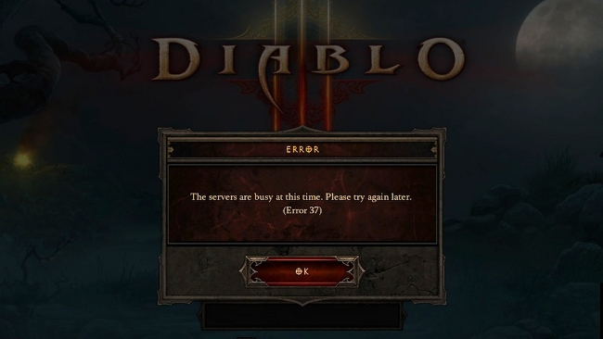

Diablo III Launch May 15, 2012
As well as ‘Pokemon No’ 2016

Slide 38
Scaling Effects
Scaling Effects: Failures occur when increasing n, as scaling often goes as O(n^2) or worse
Point-to-point communication between servers scale as O(n^2)
Development environment: one server 1 connection
Staging environment: two servers 4 connections
Production environment: 16 servers 256 connections !
Shared resources are resources that all services must access to get work done (akin ‘singleton pattern’)
Saturation → connection backlog
Backlog exceeds listen queue → failures

Slide 39
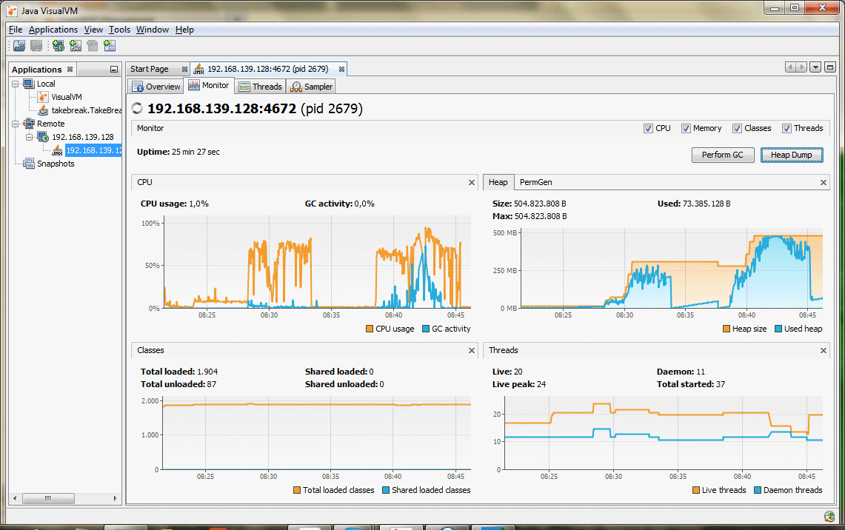
Unbalanced Capacities
Example: The Lyon airport stress test I did in… Lyon airp.
Throttling up the producer rate of sending messages
Strain ☺
My daemon code was single-threaded, so WTF???
”fetch msg from MQ, convert, store in MongoDB”
Producer
Karibu:
Pull message, convert, store in Mongo, repeat
MQ
Karibu
Mongo
Notes:
This ‘gobbling up memory in the daemon’ bug caused me a lot of headaches. Apparently the flow was lockstep, with only a single process daemon, which ”fetch message, decode, store in DB’ and thus there should be no unbalanced capacity.

Slide 40
Unbalanced Capacities
It turned out that
RabbitMQ can deliver message at vastly higher speeds than MongoDB can ever store them (not surprising, but…)
The RabbitMQ Java connector/driver uses prefetch
Fetch next message even though the last has not been acknowledged by my daemon code yet!
(And where was that described in the documentation???)
Limit on prefetch: default is ∞ thanks!
Result: Chain reaction due to GC overload
Stemming from unbalanced capacities (mq vrs db)

Slide 41
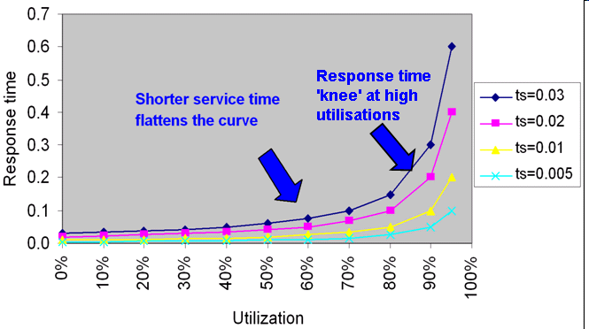
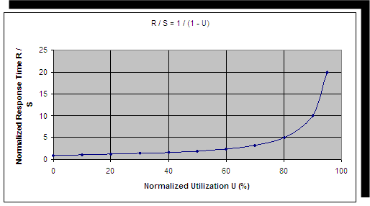
All systems have a limit
Around 70% utilization the response time exceeds
3 times the service time !
All systems have a limit after which performance degrades rapidly

Slide 42
Balanced System and Bottleneck Analysis
U₁
U₂
U₃
Node 1
Node 2
Node 3
A queuing system is balanced if all nodes have the same equal utilization
U₁ = U₂ = U₃
A software system can achieve its best possible, scalable performance if it’s a balanced system
Therefore you should generally consider the node with highest utilization when you need to optimize a system (this is typically where the bottleneck is)
And generally stop when the system is balanced

Slide 43
Unbalanced Capacities
Unbalanced Capacity: The mismatch between capacity of system parts that participate in handling transactions [own definition]
Note
Depends on particular usage profile
Particularly subject to ‘Attacks of self denial’
That is, suddenly the usage profile change dramatically
The Kähler vase case; Black Friday; Christmas sales…
Difficult to test as ratios often differ in QA and prod.
QA: often front-end is 1-1 but in prod. 10-1
Notes:
Ex: Web servers can handle 10x more traffic than the sales-handling servers, as only one of each 10 web browsing transactions result in a sale. Fine; but then the ‘most wanted vase’ suddenly goes on sale and the ratio changes to 2-1 instead!

Slide 44
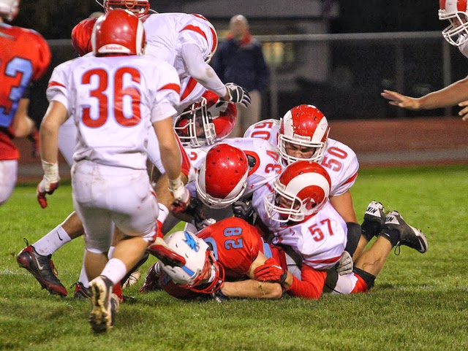
Dogpile
Dogpile: A large set of starting/initializing servers generate an impulse that generates a cascading failure [own definition]
Or
Startup/periodic load may be much higher than steady-state load, triggering circuit-breaker tripping…
Can also occur when external event trigger synchronization of traffic
Like pedestrian stoplights…
Notes:
Startup means ‘warming caches’

Slide 45
Dogpile
Anyone from my SAiP fagpakke?
One important aspect of the load generator is the gaussian delay in the workload model
Why is that extremely important?
How to avoid dogpiles?
Architectures must be crafted to acknowledge their existence and take preventive measures.

Slide 46
Dogpile
Even swarm has a dogpile akin-of problem
‘depends_on’ attribute in compose-file dictate the starting order of services, but there is a difference between ‘running’ and ‘ready-for-work’ state…
We will return to dockerfile HEALTHCHECK later
Can tell if a container is ‘ready-for-work’ rather than just running

Slide 47
Force Multiplier
Force Multiplier: Control plane automation can overreact (multiply the force) upon detected failures, due to incorrect assumptions or missing/incorrect control data, leading to cascading failures [Own definition]
Example:
Reddit Goal: update zookeeper cluster
Shut down autoscaler, then update zookeeper cluster
Actual process
Package mgt system detects autoscaler missing, restarts it (!)
Autoscaler reads zookeeper (partially migrated) data
Determine much less need for app and cache servers
So, starts shutting down a lot of servers
The package management ‘multiplied the force’ on system…

Slide 48
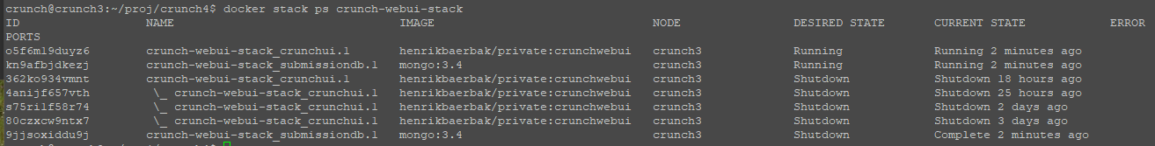
Even Swarm
I had one incident, a crashing version of SkyCave daemon sneaked by my pipeline test
Upon redeploying the stack…
(I was experimenting with rollback, but obviously got it wrong)
… swarm just restarted services, saw them crash, and restarted
Eventually my machine would ‘Unsteady State’ crash

Slide 49
Safeguards
Generally, the hardware/robotics guys are better at it…
Industrial robots have multiple layers of safeguards to prevent damage to people and facilities…
So encode safeguards in software
If 80% of system is suddenly gone, it is probably you that observes a distorted version of the world
If gap between observed and desired state is large, ask for human intervention/confirmation
Hysteresis:
Start VMs quickly, stop them slowly.
VMs takes time to start handling load, so do not start another one 10ms after – even if you see load not decreasing right now…
The Governor Pattern

Slide 50
Slow Responses
Slow Response: One system part starts to respond slowly
Easily triggers a ‘cascading failure’, as depending systems of course also starts responding slowly
Example:
Single-threaded SkyCave (‘socket.cpf’)
If user 1 invokes ‘quote’ and it takes 10 minutes to respond…
Then what will user 2, 3, 4, … experience?

Slide 51
SLA Inversion ^{(*)}
SLA Inversion: The best SLA you can offer is the worst SLA of any external software system you depend upon.
If your system depends upon service X that offers only 88% availability, how can you promise 99,999%?
Example: The cookie service I relied upon had very low availability…
(*) Removed from his second edition…

Slide 52
Unbounded Result Sets
Unbounded Result Sets: Queries may return many more elements than expected
Query, loop-over-elements
Works well with 230 elements, but 5.000.000 ?
And the result?
Ressource strain, slow response, cascading failure, …
Always query with a limit !

Slide 53
A Similar AntiPattern
Not mentioned by Nygard directly, but
Steady state: For every mechanism that accumulate resources, some other mechanism must recycle that resource.
Then we must also have AntiPattern
Unsteady state: One or more mechanisms exist, that does not recycle resources but keeps accumulating them

Slide 54
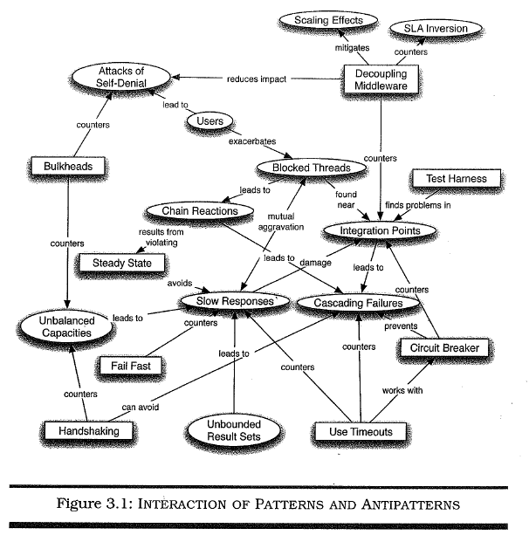
Summary ^{(*)}
First Ed.

